Slide 1

Educational Word Explorer in Indian Language
VIGNESH GUNDARI - 23106008
KAUSTUBH BHOIR - 23106066
VARUN BURA - 23106129
ATHANG JADHAV - 23106039
Project Guide
Ms. Taruna Sharma
Academic year 2024-25
Notes:
1

Slide 2
Outline
Introduction
Literature Survey of the Existing Systems
Problem Statement
System Design
Technologies and Methodologies
Implementation Screenshots(Partial )
Conclusion
References
Notes:
2

Slide 3
Introduction
In a country as diverse as India, language plays a crucial role in education and communication. Hindi, being one of the most widely spoken languages in the country, holds significant importance in the academic curriculum and daily conversations. However, despite its prominence, there is often a lack of engaging and innovative methods for learning Hindi, especially for younger generations who are more inclined towards digital learning.
The rapid growth of technology and digital education has created opportunities to integrate gamification into language learning. Games have proven to be powerful tools for education, fostering engagement, motivation, and retention. The Educational Word Explorer Game in Indian Language is designed to bridge the gap between traditional language education and modern digital learning techniques. By combining interactive gameplay, multimedia elements, and structured language lessons, the game serves as an effective tool for developing linguistic skills while keeping learners entertained.
Notes:
3

Slide 4
Motivation: Rote memorization often leads to disengagement and poor retention. The Educational Word Explorer Game encourages practical language use through interactive challenges like word puzzles, sentence formation. By applying Hindi in real-life contexts, learners build comprehension, retention, and fluency, making the learning process more effective and enjoyable.
Objectives: The Educational Word Explorer Game creates a meaningful learning experience by using puzzles and quizzes that make Hindi learning engaging and interactive. These activities help users expand their vocabulary, improve spelling accuracy, and grasp grammar concepts in a fun and practical way. By actively solving challenges, learners reinforce their understanding, making language acquisition more effective and enjoyable.
Notes:
4

Slide 5
Literature Survey of the Existing System
Title | Release Date | Description | Our advancement
Engaging Students in the Learning Process with Game-Based Learning | 2021 | This study highlights how game-based learning increases engagement and improves critical thinking, aligning with our goal of making Hindi learning interactive and enjoyable. | Shabda Chakra not only applies game-based learning to Hindi but also provides instant feedback, allowing learners to correct and reinforce their understanding on the spot.
Game On: Exploring the Effectiveness of Game-Based Learning | 2020 | The study confirms that students find game-based learning more engaging than traditional teaching, reinforcing our decision to make Hindi learning fun through interactive challenges. | Chakra dynamically adjusts difficulty based on the player's progress, ensuring a personalized and effective learning experience.
The Impact of Game-Based Teaching Practices on Different Curricula | 2021 | This research supports the idea that game-based teaching improves academic performance, validating our approach to using games for Hindi vocabulary building. | We transformed this research into action by creating a fully functional game that allows real users to experience and benefit from game-based learning.
Title | Author | Description
Notes:
5

Slide 6
Literature Survey of the Existing System
Title | Release Date | Description | Our advancement
Effects of Game-Based Learning on Attitude and Achievement in Elementary Mathematics | 2019 | The study shows that game-based learning enhances students’ attitudes towards a subject and improves problem-solving, just like our game makes Hindi learning more engaging and effective. | Shabda Chakra applies these game-based techniques to language learning and offers two unique game modes for a richer learning experience.
Foundations of Game-Based Learning | 2015 | This research establishes the theoretical framework for how games support cognitive, motivational, and social learning, which aligns with our goal of making Hindi learning immersive. | Shabda Chakra brings these theories to life by offering a fully developed, interactive platform for Hindi learners to practice in a structured and engaging way.
Title | Author | Description
Notes:
6

Slide 7
Literature Survey of the Existing System
Title | Release Date | Description | Our advancement
Effectiveness of Digital Game-Based Learning Strategy in Higher Education | 2023 | The study shows that digital game-based learning (DGBL) is effective in developing critical thinking and engagement, similar to how our game enhances Hindi vocabulary skills. | Shabda Chakra is designed for all age groups, making it a more inclusive and widely accessible tool for Hindi learners of different skill levels.
Title | Author | Description
Notes:
7

Slide 8
Problem statement
Traditional methods of learning and improving language skills often feel monotonous and fail to engage learners effectively. In a world driven by digital interactions, there is a growing need for educational tools that combine fun and learning to keep users motivated. Many learners struggle to enhance their vocabulary, spelling, and critical thinking in an enjoyable and interactive way. An educational game that merges entertainment with meaningful learning experiences can address this gap and make language development both accessible and engaging.

Slide 9
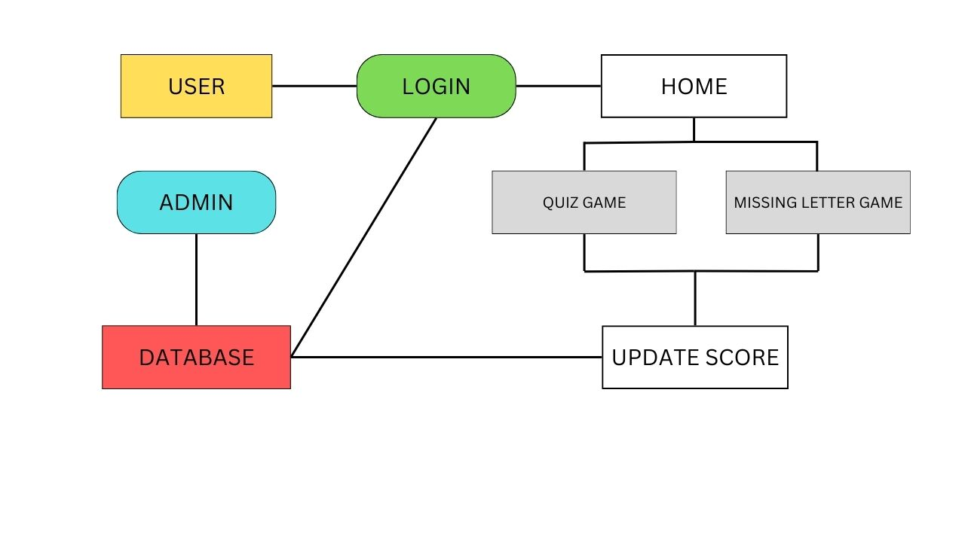
System Design
Notes:
9

Slide 10
System Design
Dual Game Modes:
Quiz Mode for word guessing from clues and Guessing Alphabets Mode to fill in blanks.
Interactive Gameplay:
Intuitive interface with real-time feedback.
Score Tracking:
Tracks progress and rewards accuracy and speed.
Educational Value:
Enhances vocabulary, spelling, and cognitive skills.
Accessibility:
Designed for all ages.
Notes:
10

Slide 11
Technologies and Methodologies
Platforms and Technologies
Front-End: Web-based UI using frameworks like CSS, HTML and FLASK.
Back-End: Server-side logic implemented using python
Database: My-SQL for database management
Notes:
11

Slide 12
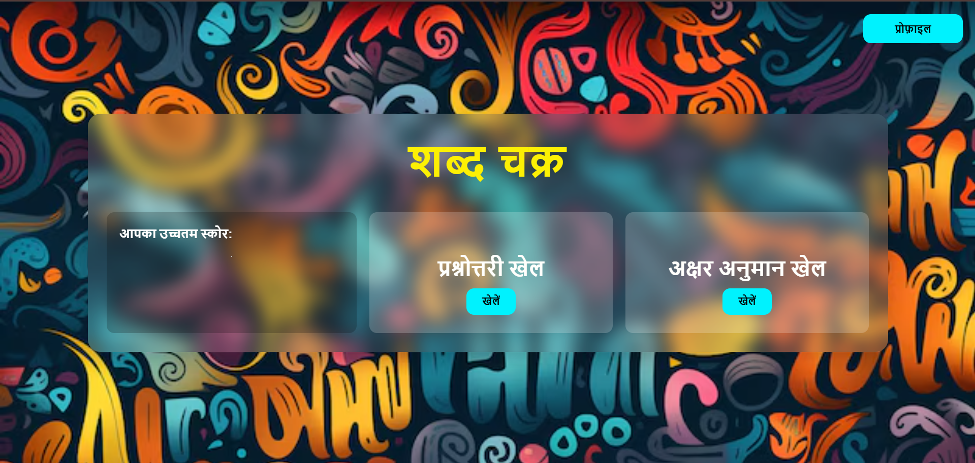
Implementation
Notes:
12

Slide 13
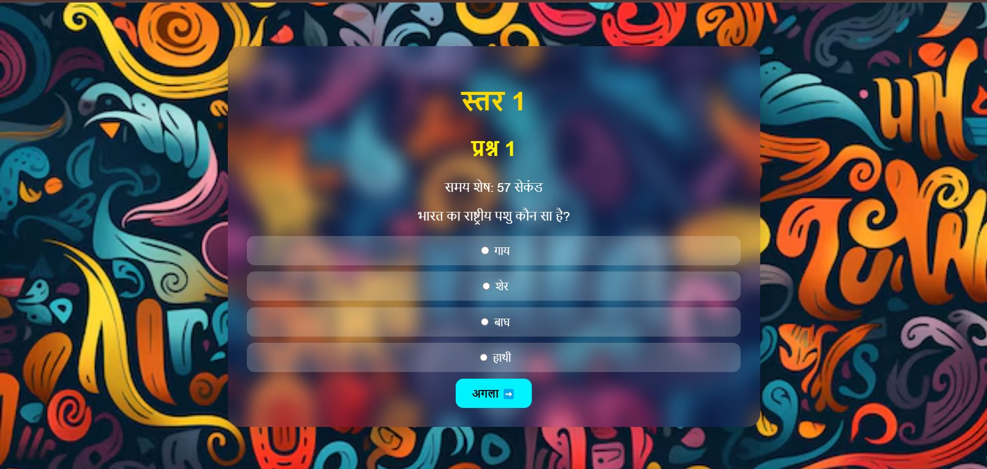
Notes:
13

Slide 14
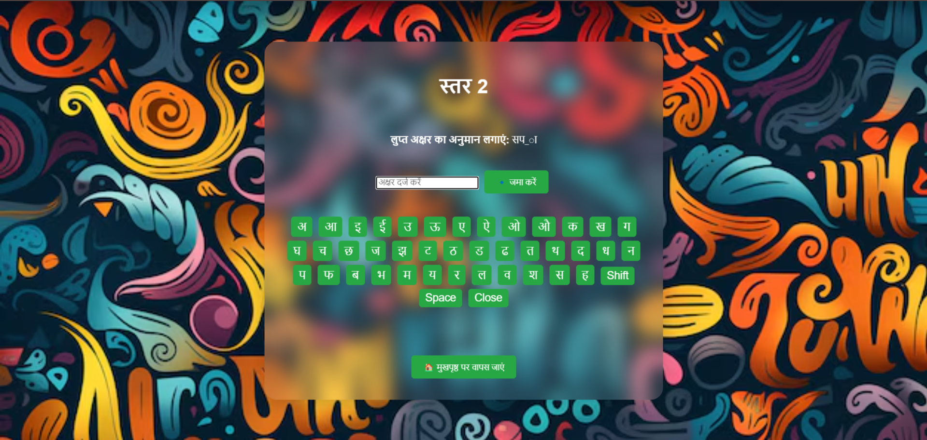
Notes:
14

Slide 15
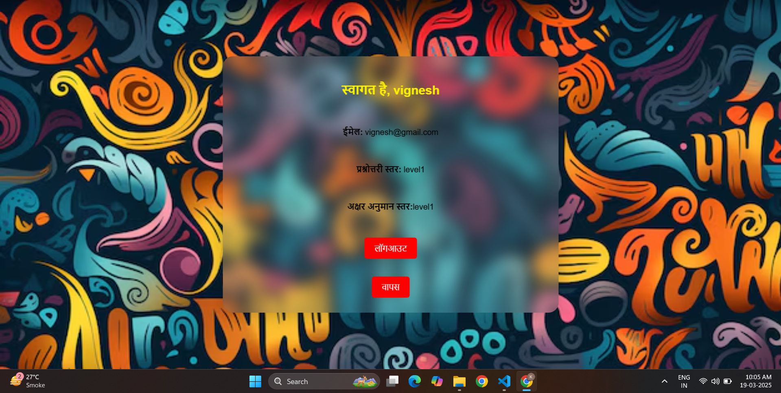
Notes:
15

Slide 16
Conclusion
The Shabda Chakra web-based game is an interactive platform designed to enhance users’ Hindi vocabulary and cognitive skills through two engaging modes: Quiz Game and Letter Guessing Game. With a user-friendly interface, real-time score tracking, and the requirement of a Hindi Phonetic Keyboard, the game provides an immersive and educational experience. Being web-based, it ensures accessibility from any device without additional software installations. The admin panel enables easy management of user performance, making the system scalable for future enhancements. Overall, Shabda Chakra serves as an effective learning tool for students, professionals, and language learners, offering an engaging approach to Hindi language development. Future improvements may include advanced difficulty levels, multiplayer features, and AI-based personalized learning paths to enhance user experience
Notes:
16

Slide 17
References
[1] https://files.eric.ed.gov/fulltext/EJ1311472.pdf
[2] https://faculty.ist.psu.edu/hadi/papers/JPPR20_HHM.pdf
[3] https://files.eric.ed.gov/fulltext/EJ1294062.pdf
[4] https://files.eric.ed.gov/fulltext/EJ1206814.pdf
[5] https://files.eric.ed.gov/fulltext/EJ1090277.pdf
[6] https://files.eric.ed.gov/fulltext/EJ1372872.pdf
Notes:
17

Slide 18
Thank You...!!
Notes:
18

